Slide 1

Learned Robust PCA: A Scalable Deep Unfolding Approach for High-Dimensional Outlier Detection
HanQin Cai, et al.
University of California, Los Angeles
NeurIPS 2021

Slide 2
Introduction
Background:
Robust principal component analysis (RPCA) has received intensive investigations in a wide range of tasks → PCA is known for its high sensitivity to outliers → RPCA: Y = X + S, X is a low-rank matrix, S is a sparse matrix ;
Motivation and Problem Setting:
One of the main challenges of designing an RPCA is to avoid high computational costs;
Inspired by deep unfolded sparse coding, some works extended deep unfolding techniques to RPCA; → Nevertheless, all these call an expensive step of singular value thresholding (SVT): a full or truncated singular value decomposition (SVD); → Thus, these approaches are not scalable to high-dimensional
Another issue is that the existing approaches only learn the parameters for a finite number of iterations.
“Can one design a highly efficient and easy-to-learn method for high- dimensional RPCA problems?” and “Do we have to restrict ourselves to finite-iteration unfolding (or a fixed-layer neural network)?
Contributions:
We propose a scalable and learnable approach for high-dimensional PRCA problem, which has a flexible feedforward-recurrent-mixed neural network model for potentially infinite-iteration unfolding.

Slide 3
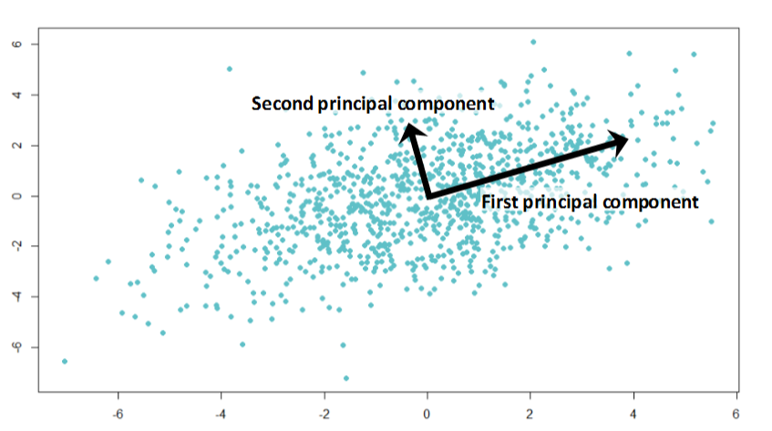
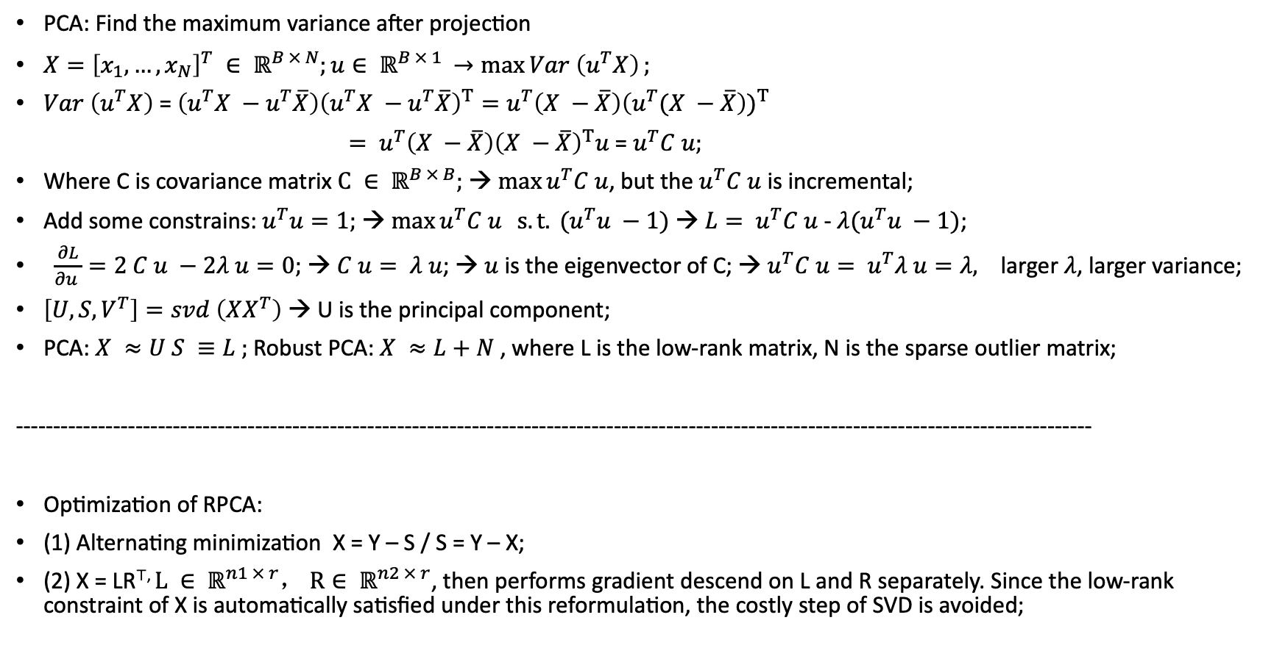
Background Knowledge:
PCA: Find the maximum variance after projection
$X={\left[x_{1}, …, x_{N}\right]}^{T} ∈ ℝ^{B × N};u∈ ℝ^{B × 1 }→\max{Var \left(u^{T}X\right)};$
$Var \left(u^{T}X\right)$ = $\left(u^{T}X −u^{T}\overline{X}\right){\left(u^{T}X −u^{T}\overline{X}\right)}^{T}=u^{T}\left(X −\overline{X}\right){\left(u^{T}(X −\overline{X}\right))}^{T}$
$= u^{T}\left(X −\overline{X}\right){\left(X −\overline{X}\right)}^{T}u$ = $u^{T}C u;$
Where C is covariance matrix $C ∈ ℝ^{B × B};$ → $\max{u^{T}C u}$, but the $u^{T}C u$ is incremental;
Add some constrains: $u^{T}u=1;$ → $\max{u^{T}C u} s.t. (u^{T}u −1)$ → ${L= u}^{T}C u$ - $λ(u^{T}u −1)$;
$\frac{∂L}{∂u }=2 C u −2λ u=0;$ → $C u= λ u$; → $u$ is the eigenvector of C; → $u^{T}C u= u^{T}λ u=λ, \text{larger} λ$, larger variance;
$\left[U, S, V^{T}\right]=svd \left(XX^{T}\right)$ → U is the principal component;
PCA: $X ≈U S ≡L ;$Robust PCA: $X ≈L+N$, where L is the low-rank matrix, N is the sparse outlier matrix;
------------------------------------------------------------------------------------------------------------------------------------------------
Optimization of RPCA:
(1) Alternating minimization X = Y – S / S = Y – X;
(2) X = LR⊤, $L ∈ ℝ^{n1 × r}， R∈ ℝ^{n2 × r}$, then performs gradient descend on L and R separately. Since the low-rank constraint of X is automatically satisfied under this reformulation, the costly step of SVD is avoided;

Slide 4
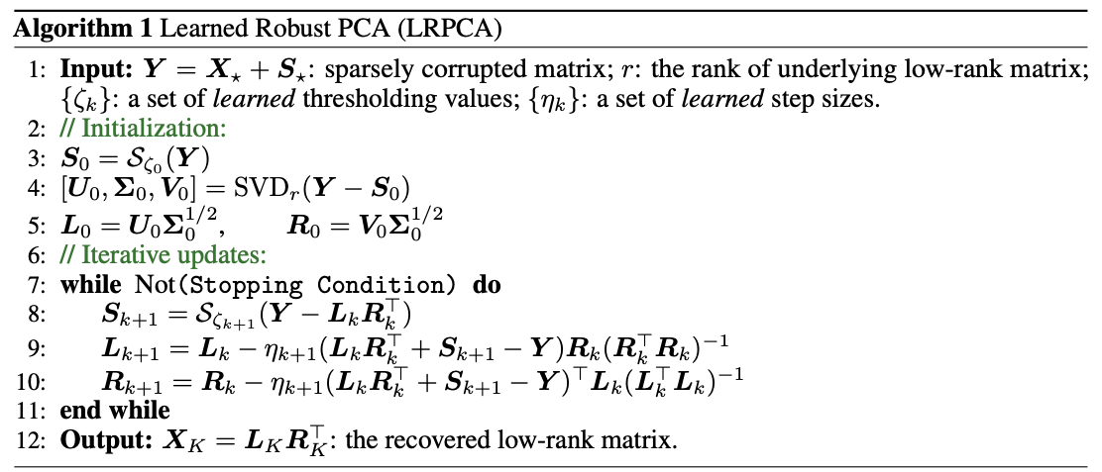
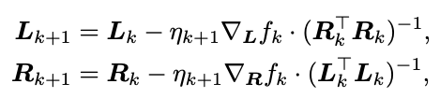
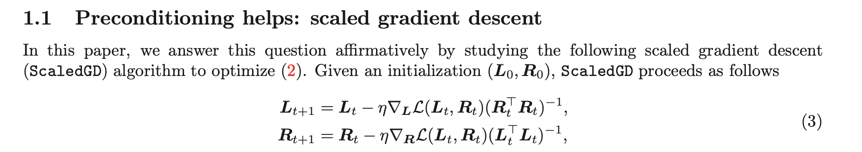
Method:
[1] T. Tong, et al., “Accelerating Ill-Conditioned Low-Rank Matrix Estimation via Scaled Gradient Descent” 2021.

Slide 5
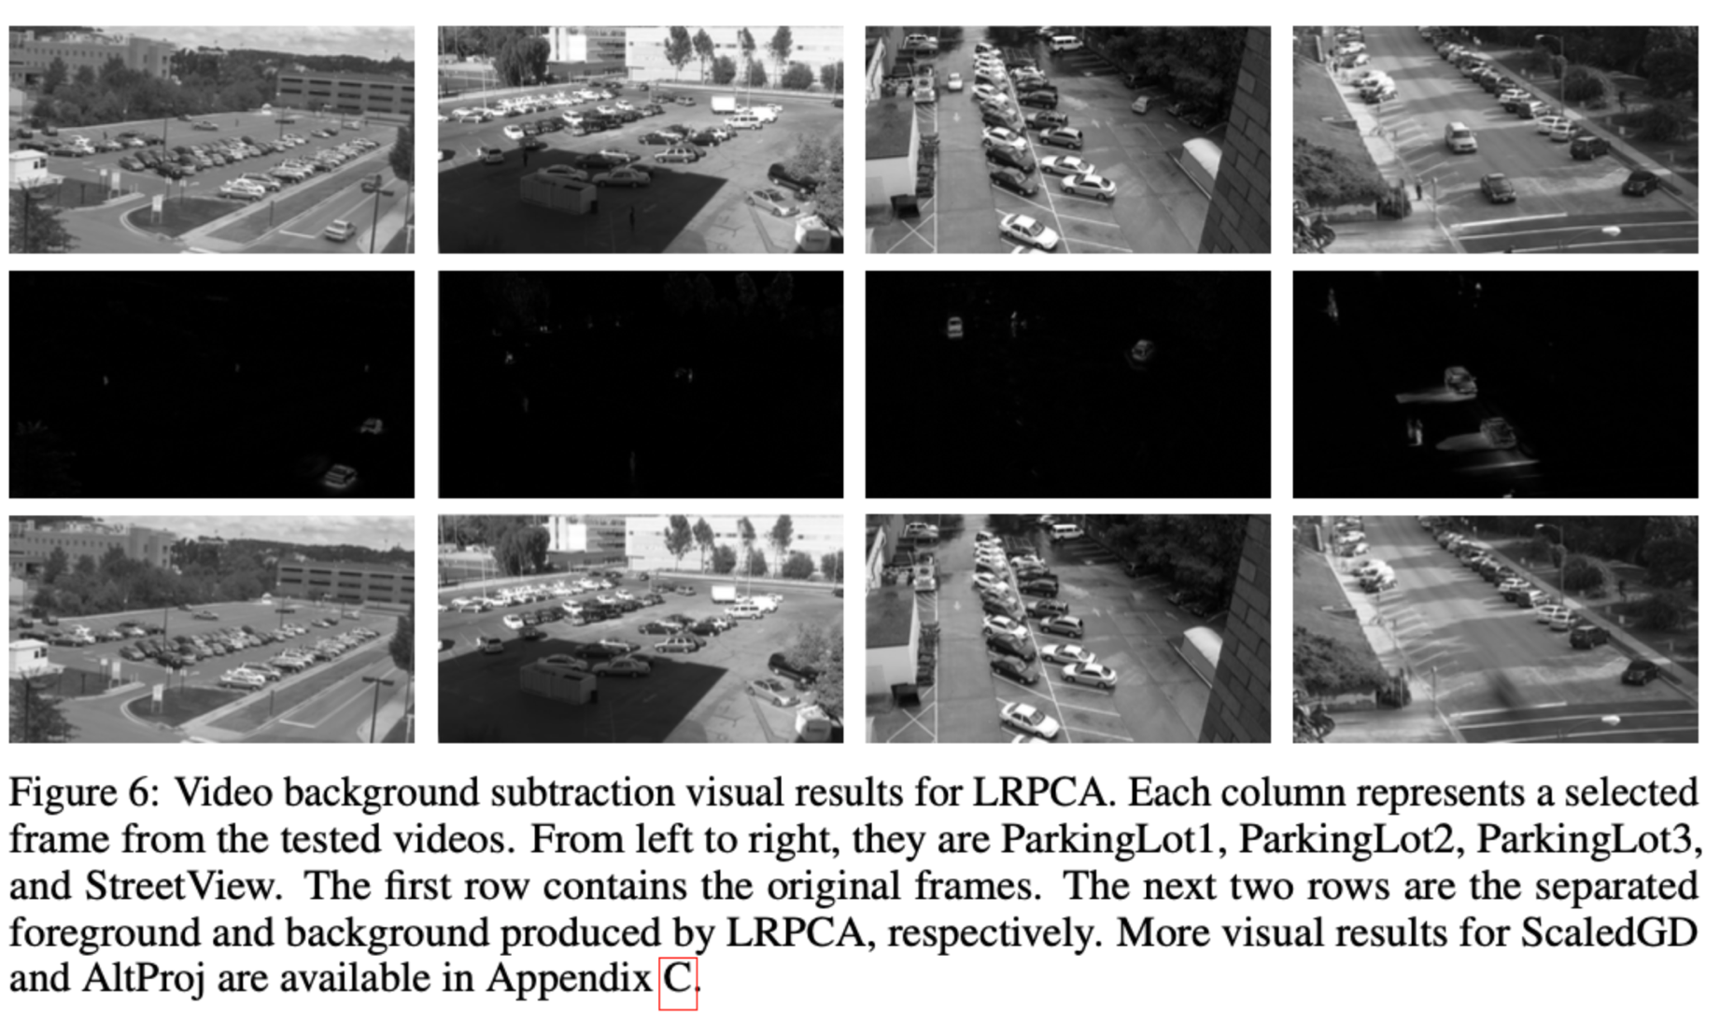
Results:

